Slide 1
Types of Data
Data can be classified into three main categories based on its structure: Structured, Semi-structured and Unstructured. Structured Data: Data that is organized in a well-defined manner, such as in a table or database. Examples of Structured Data include: -Customer Data in a CRM System, with fields for name, address, email, and phone number. -Stock Market Data in a financial database, with fields for date, closing price, and volume traded. Semi-structured Data: Data that has some structure, but also contains unstructured elements. Examples of Semi-structured Data include: - Social media posts, which have a author, timestamp, and text, but the text may contain hashtags, mentions, andemojis. - NoSQL Database Data, JSON (JavaScript Object Notation) or XML (Extensible Markup Language) data, which has a nested structure, but the values may contain unstructured text or binary data.

Slide 2
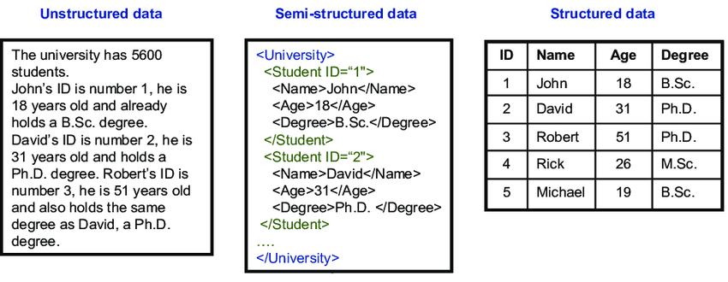
Types of Data
Unstructured Data: Data that does not have a well-defined structure and may not fit neatly into a table or database. Examples of unstructured data include: - Images, such as photographs and medical images. - Videos, such as movies and TV shows.
Semi-structured and unstructured data require additional processing and analysis techniques compared to structured data, as they do not have a well-defined structure and may contain complex relationships between elements.

Slide 3
Types of Variable & Data
Numerical Variable: Data that can be expressed as a number, such as Height, Weight, Age, and Income. There are two types of numerical variable: Continuous (e.g., Height, which can take on any value) and Discrete (e.g., Number of Children in a household, which can only take on certain values).
Categorical Variable: Data that can be divided into categories, such as Gender, Hair Color, and Education Level. There are two types of categorical variable: Nominal (e.g., Hair Color, which has no order) and Ordinal (e.g., education level, which has an order, such as "Primary School," "High School," and "College").
Binary/Dummy Variable: Data that can only take on two values, such as "yes/no" or "present/absent."
Time Series Data: Data that is collected over time, such as Stock Prices, Weather data, and Sales data.
Text Data: Data that is in the form of text, such as customer reviews, emails, and social media posts.
Image Data: Data that is in the form of images, such as photographs, medical images, and satellite images.
Audio Data: Data that is in the form of sound, such as speech, music, and environmental sounds.
Video Data: Data that is in the form of video, such as movies, TV shows, and surveillance footage.

Slide 4
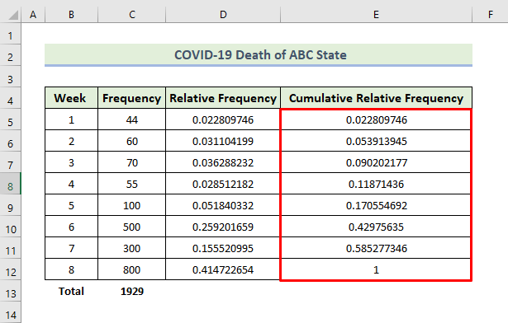
Types of Frequency Distribution
There are three types of Frequency that are frequently used in Data Analysis:
Frequency (Count)
Relative Frequency (Ratio/Percentage)
Cumulative Frequency (Rolling)

Slide 5
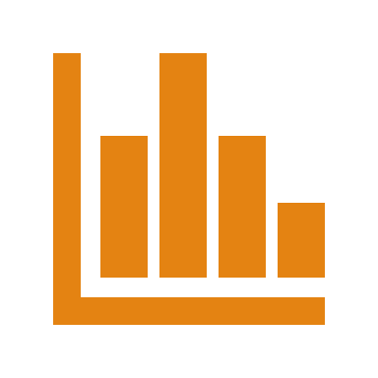
Measures of Central Tendency
Measures of central tendency are statistical methods used to describe the "center" or "typical" value of a set of data. There are three main measures of central tendency:
Mean/Average: Average of all the values in a set of data. - Arithmetic Mean (AM) - Geometric Mean (GM) - Harmonic Mean (HM)
Median: The median is the middle value in a set of data when the data is ordered from smallest to largest. If the set has an odd number of values, the median is the middle value. If the set has an even number of values, the median is the average of the two middle values.
Mode: The mode is the value that occurs most frequently in a set of data. A set of data can have one mode, more than one mode, or no mode.
Each measure of central tendency provides a different representation of the "typical" value in a set of data, and the appropriate measure to use depends on the characteristics of the data and the question being asked. For example, the mean is sensitive to extreme values (outliers) and may not be an appropriate measure if the data has a skewed distribution, while the median is not affected by outliers and is a better measure in such cases.

Slide 6
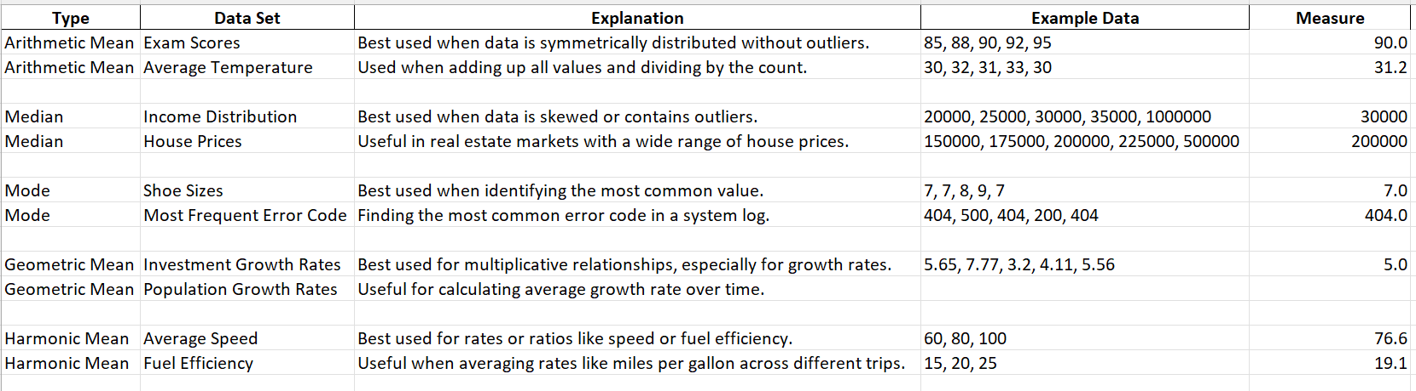
Measures of Central Tendency

Slide 7
Measures of Location
Measures of location describe any specific position/value of a set of data. Mean, Median, and Mode are also part of this, but measures of location refers to:
Quartiles: They are the values that divide a set of data into four equal parts. The lower quartile (Q1) is the 25th percentile, the median (Q2) is the 50th percentile, and the upper quartile (Q3) is the 75th percentile. Example: In a set of [1, 2, 3, 4, 5, 6, 7, 8, 9, 10], Q1 would be the value separating the lowest 25% of data from the rest, Q2 would be the median, and Q3 would be the value separating the highest 25% of data from the rest.
Deciles: They are the values that divide a set of data into ten equal parts. The first decile (D1) is the 10th percentile, the second decile (D2) is the 20th percentile, and so on. Example: In a set of [1, 2, 3, 4, 5, 6, 7, 8, 9, 10], D1 would be the value separating the lowest 10% of data from the rest, D2 would be the value separating the lowest 20% of data from the rest, and so on.
Percentiles: They are values that divide a set of data into 100 equal parts. The nth percentile is the value that separates the lowest n% of data from the rest. Example: In a set of [1, 2, 3, 4, 5, 6, 7, 8, 9, 10], the 40th percentile would be the value separating the lowest 40% of data from the rest.

Slide 8
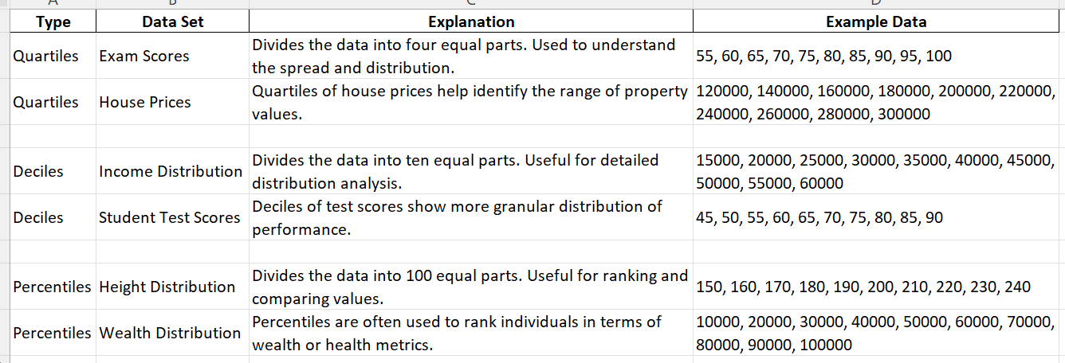

Slide 9
Plots Require to Explore your Data
There are many types of plot available, but we will only discuss about the ones frequently used in Data Analysis, Data Science & Machine Learning:
For Univariate Analysis - Numerical Variable: - Histogram, Density Plot - Box and Whisker Plot - Qualitative Data: - Bar/Column Plot, Tree Plot - Pie Chart, Donut Chart & Radar Chart
For Bivariate Analysis - Numerical Data: - Scatter Plot - Correlogram/Correlation Plot, Heat plot - Line Chart (Against Time) - Categorical Data - Stacked/Clustered Bar Chart

Slide 10
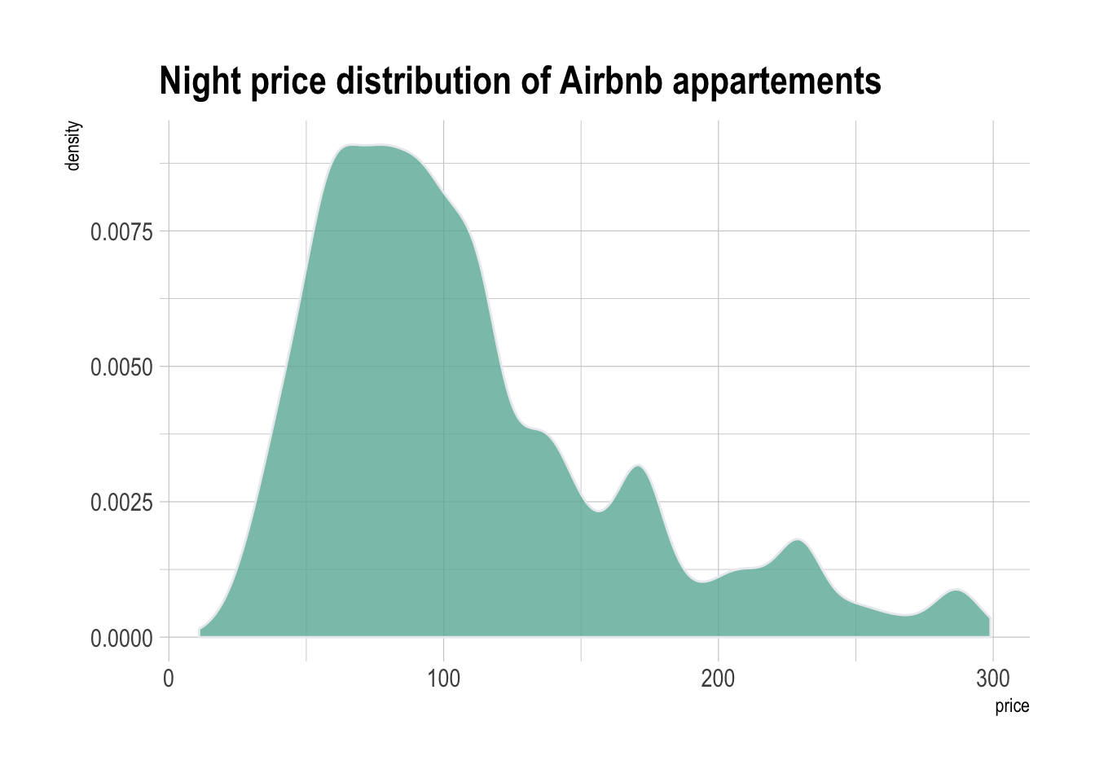
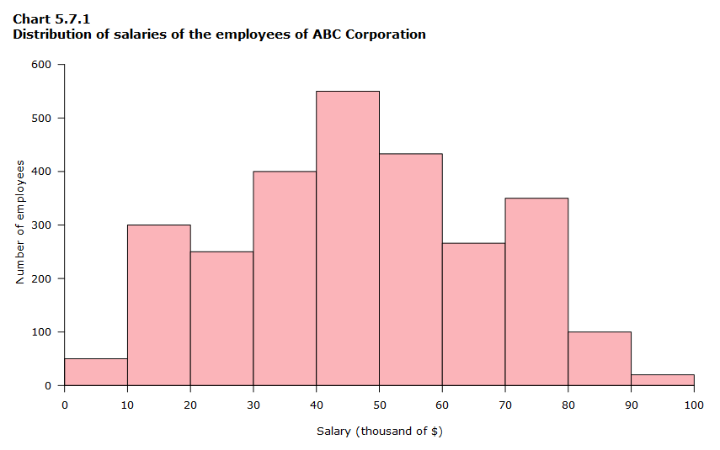
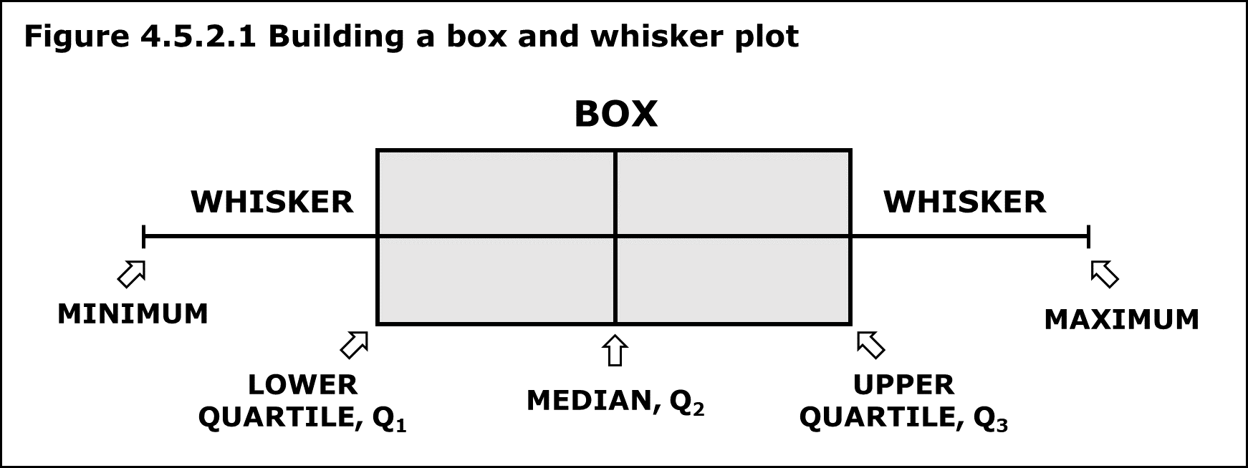
Density Plot, Histogram, Box & Whisker Plot

Slide 11
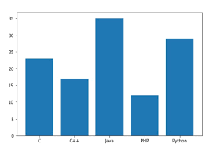
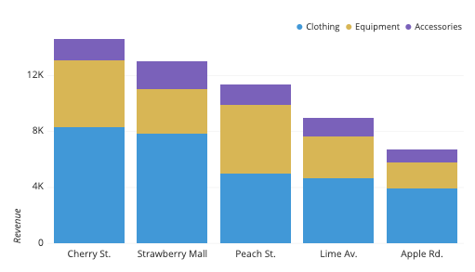
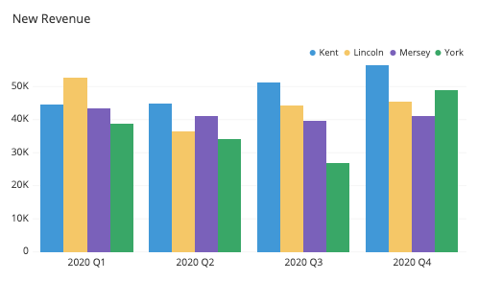
Bar Plot, Stacked Bar Plot, Clustered/Group Bar Plot

Slide 12
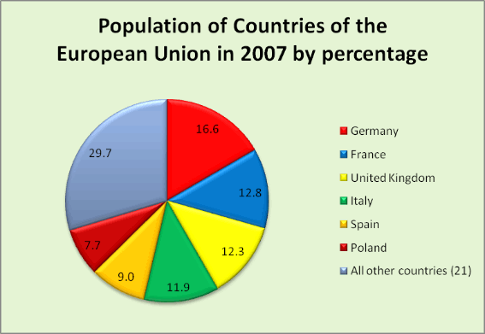
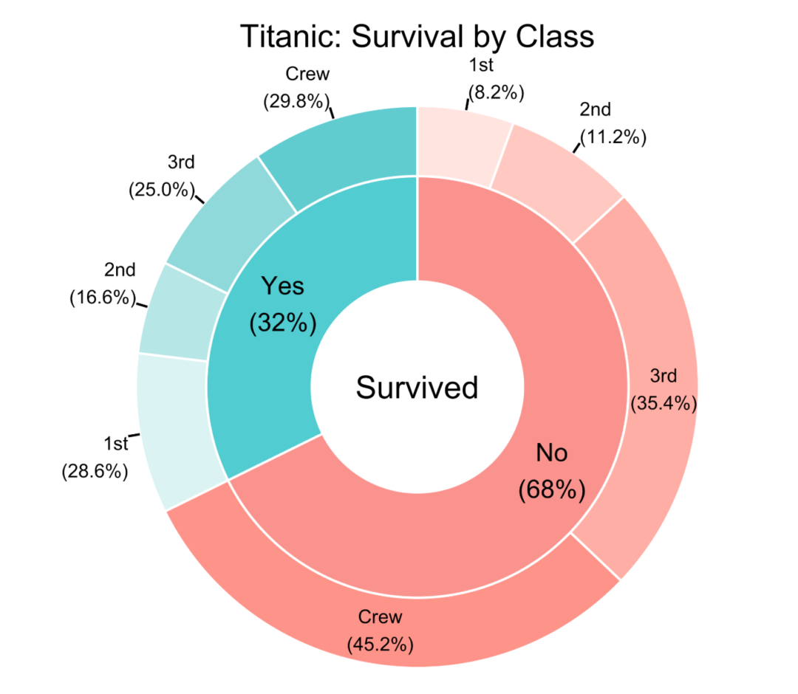
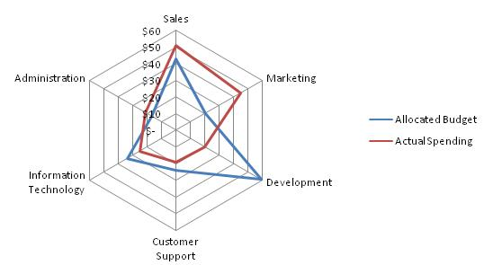
Pie Chart, Donut & Radar Chart

Slide 13
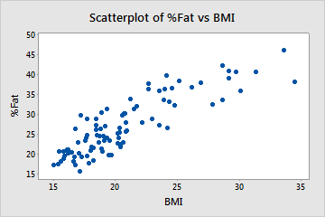
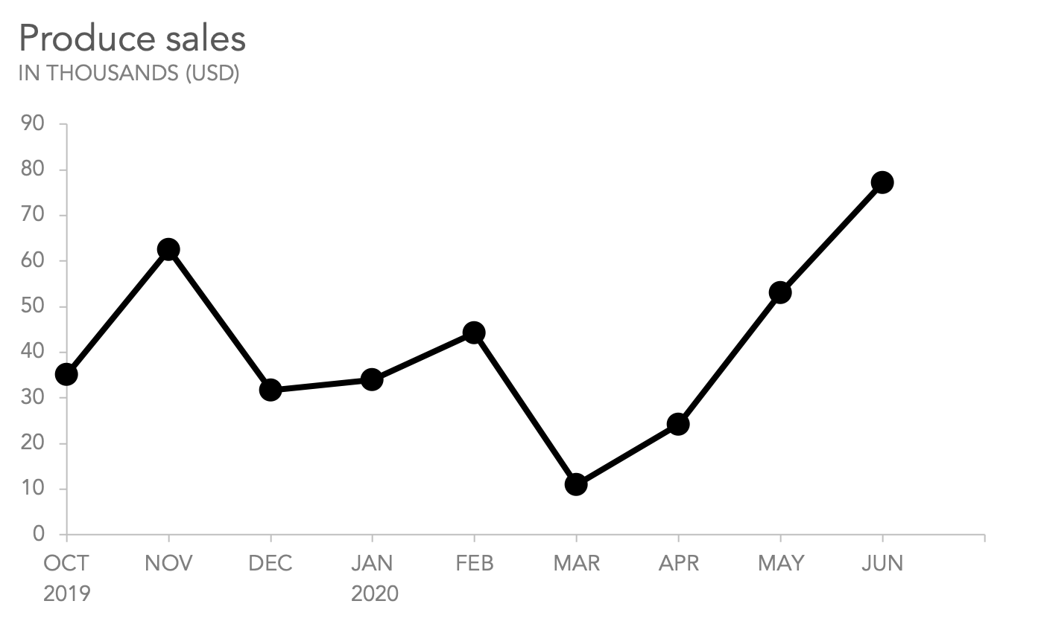
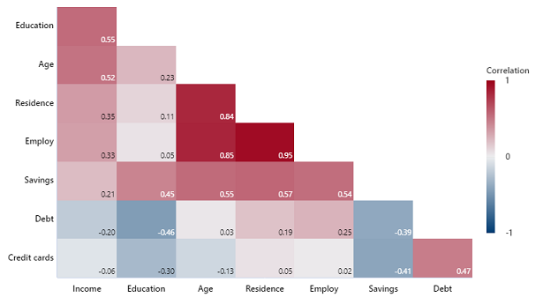
Scatter Plot, Line Chart & Correlogram

